Slide 1

CP352301 Script Programming
$ vim helloworld.py #!/usr/bin/python
# Hello world python program print "Hello World!"
$ whereis python
$ which python
$ python helloworld.py Hello World!
( or )
$ chmod u+x helloworld.py $ ./helloworld.py
Hello World!
1/2026 (self-paced on-site, hybrid, online, project-based learning with certificate)
Assistant Professor Boonsup Waikham
$ python -c 'print "Hello World!"'

Slide 2
Administrative
Onsite Class:
SEC1: Onsite WED 15:00-19.000 SC6601B
SEC2: Onsite TUE 8:30-12:30 SC9226
Makeup Class: All SEC – SAT 13.00-15.00 (if any)
Online Self-Study: Codecademy.com [Python2] and Netacad.com [Script Programming 1/26 [Python Essentials 1] and Script Programming 2/26 [Python Essentials 2]
Certificate exams

Slide 3
Communications
NotebookLM:
https://notebooklm.google.com/notebook/936b004b-36ff-41cf-ab75-49adc6949af0
CISCO NETACAD:
https://www.netacad.com/courses/python-essentials-1?courseLang=en-US&instance_id=deb64081-e4f6-42f4-bb07-408410f4fdb9
Instructor:
Email: boonsup@kku.ac.th

Slide 4
Python Basics

Slide 5
Python Basics
Sprints

Slide 6
Python Basics
Sprints
Final Project

Slide 7
Course Topics
Part I Basics of Python (Lec & Online Self-Study)
Intro to Python and Syntax
Strings and Console Output
Conditionals and Control Flow
Functions
Lists & Dictionaries
Lists and Functions
Loops
Advanced Topics in Python
Introduction to Classes
File Input and Output
Part II Application of Python (Labs & Experiments)
Systems and Network Programming
Python for modern apps
Part III Project and Conclusions (Ideas and Execution)
mini Project (midterm)
term Project (final)
Final Exam

Slide 8
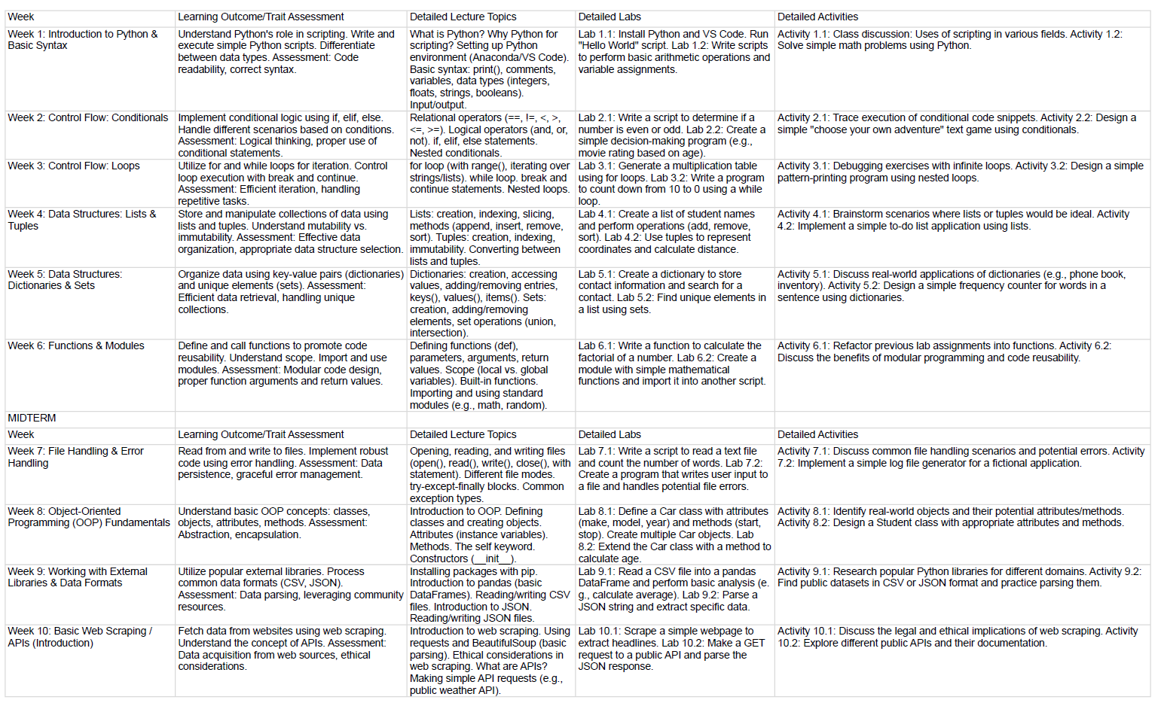
Lec & Lab Schedule: Part I Script Language

Slide 9
Learning Objectives
Explain the common characteristics of Script Programming
Apply regular expressions
Author shell scripts to automate workflows
Utilize Python to solve a wide range of text processing problems
Understand differences in a web based environment
Employ Python as a object-oriented scripting language
Define and develop Networked applications

Slide 10
Course Policies
On-Time Submission
Late Assignments
Extra Credit
Questions, Concerns and Special Needs

Slide 11
Classroom Etiquette
Arriving on time and remaining for the full lecture.
Not talking during lecture.
Setting cell phones to vibrate or silent.
Using laptops in an appropriate manner.

Slide 12
Course Requirements
Class Participation
Reading & Watching
Self-Learning and Practicing
Group Presentation and Projects
Quizzes
Final Exam for Course Certificate (CISCO & CODECADEMY)

Slide 13
Responsibility for the class learning experience
Individual responsibility
Share code and example for any Python-related topics from Stack Overflow or other source to the facebook group.
Discuss the code and example.
Troubleshoot any problem/issue related to the code and example.
Group responsibility
Share tutorial for the topics learned during the week from any sources to the facebook group.
Help the online tutorial session via Skype, Team viewer, etc after class.
Troubleshoot any problem/issue related to the tutorial.

Slide 14
Why do you want to study this course?
This is an elective course. No one is forced to study.
This course might be useful in the future.
I’m really interested in script program in general and Python in specific.
The later tends to achieve for higher mark.

Slide 15
Programming is “Life Skill.”
Study in new environments
Difficult time of life
Privacy and financials

Slide 16
Programming requires multiple skills
Basic syntax
Semantics
Structure
Style
“Programming is learn by programming.”

Slide 17
Grading
Onsite Class Attendance (LEC & LAB) 10%
Certificate and Portfolio 5%
Individual Online Study 15%
Group Assignment 20%
Rotating Role-Based Sprints 15%
Role-Specialized Final Project 15%
Final Exam 20%

Slide 18
Academic Integrity
assumes the responsibilities of an active participant in KKU's scholarly community
everyone's academic work and behavior are held to the highest standards of honesty
Cheating, fabrication, plagiarism, and helping others to commit these acts are all forms of academic dishonesty
Academic misconduct could result in suspension or dismissal

Slide 19
Projects and Presentation
Individual
Group
It is never permitted to copy code from someone else nor to provide code to someone else

Slide 20
Violations of academic integrity
Emailing code in whole or in part
Instant Messaging code in whole or in part
Posting or obtaining code in whole or in part on the web
Using free or open-source software without prior consent
Not taking the appropriate measures to protect your source code, including:
Placing your code in a public directory
Failing to lock your screen when away from your computer
Allowing someone to copy code from your monitor

Slide 21
Penalty
A project grade of zero
A 10% reduction of your semester average (one letter grade)
Actions reported to the Academic Conduct Committee

Slide 22
Suggestions for Success
Start early on the programming assignments
Start early on the programming assignments in order to get hands on experience in the language before each quiz
Ask questions. Attend lecture and ask questions to things you are unsure about. Feel free to also ask questions during office hours or via email.
Learn by yourself
Language immersion

Slide 23
A&F Grade Checklists
‘A’ Grade
Familiar with Python and Other script languages
Use/apply Python for various types of applications
Create/Innovate the-state-of-the-art applications
‘F’ Grade
Unfamiliar with Python
Not be able to use/apply Python for any application
Cannot create/innovate an application

Slide 24
Learning Target Grade
Minimal target: only to pass (D grade)
Online Self-study: Codecademy.com >= 90% or Datacamp.com >= 90%
Online Exam Netacad.com >= 50% (minimum requirement for CISCO certificate)
Maximal target: requirement (A grade)
Minimal target plus
Onsite attendance >80%
Weekly Assignment > 80%
BS and AD LAB > 80%
Mini project > 80%
Final project > 80%
Final exam > 80%

Slide 25
Study Materials
Lecture: Think Python, 1st Ebook Reference
Presentation, mini-Project and final-Project: Group Ebook Reference
Online Self-Study: codecademy.com, datacamp.com, etc.

Slide 26
Tools for better achievement
At least, but not limited to
Generative AI: Gemini, Chatgpt, DeepSeek, Copilot, etc. for knowledge acquisition and programming assistant
Colab for basic labs, weekly assignments and activities
Github for more complex and advanced labs and collaborations, porfolio
NotebookLM for course summarization and weekly activities
Python IDE: Sublime, CMD, Anaconda, Jupyter Notebook, Docker, VS Code, etc. for CLI and GUI development environment

Slide 27
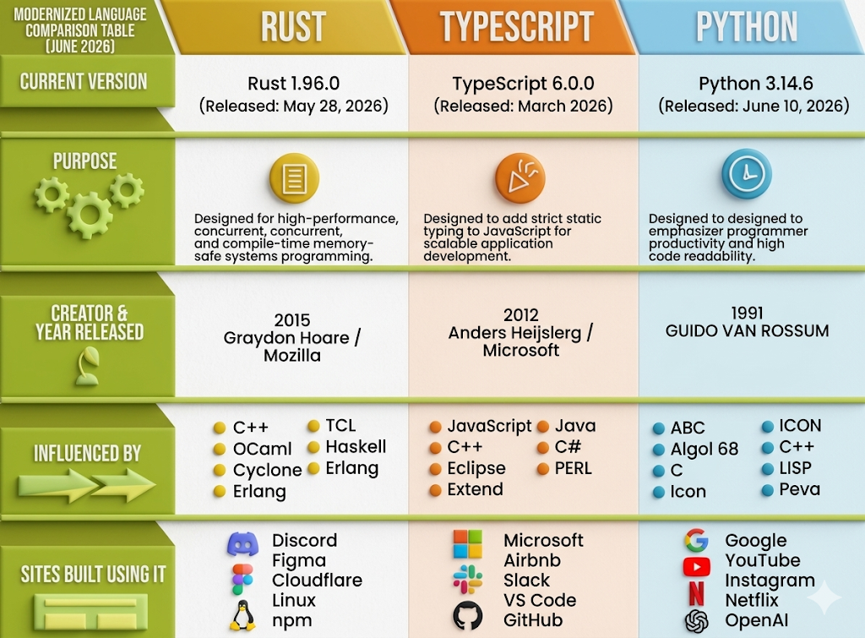
Q&A
Good luck!

